Slide 1
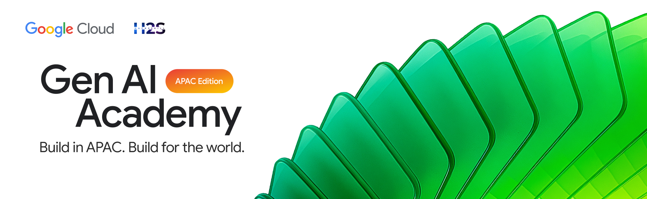
PARTICIPANT DETAILS a. Participant name : Hariharan C b. Problem Statement : Meetings create discussions, but not structured execution. Important decisions, tasks, and follow-ups are often lost in transcripts. Managers struggle to track responsibilities and team workload effectively. This leads to inefficiency, missed actions, and lack of accountability.

Slide 2
IMPORTANT LINKS
Cloud-run URL : https://meetiq-bmfbzin7kq-uc.a.run.app/
Github repo : https://github.com/BlackWizard123/MeetIQ---Agentic-Meeting-Intelligence/tree/Cloud-Run
Youtube Demo video link : https://www.youtube.com/watch?v=jdCALd0zPkI

Slide 3
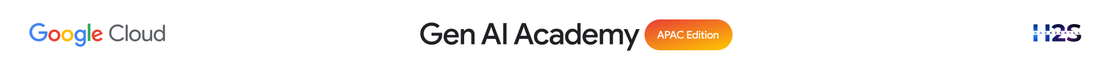
Brief about the idea
MeetIQ is a system designed to automate post-meeting workflows by converting raw meeting transcripts into structured outputs.
It processes transcripts using multiple AI agents to extract key discussion points, decisions, and action items.
Based on employee roles, skills, and current workload, tasks are intelligently assigned and tracked.
The system also generates follow-up meetings and updates Google Sheets and Calendar to maintain a centralized and up-to-date view of project execution.

Slide 4
Your solution should be able to explain the following:
How did you approach the common problem statement and translate it into a working solution using ADK, MCP/AlloyDB AI while ensuring Hackathon’s core requirements are met?
My PM was assigning tasks randomly, they were not equal, and with multiple projects to handle, tracking everything became almost impossible. I approached this by designing a multi-agent Al system using ADK, MCP and AlloyDB that takes meeting transcripts as input and automatically generates structured memos, assigns tasks fairly based on skills and workload, and keeps everything tracked in real-time.
What real-world problem does your solution address, and what practical impact does it create for users?
It solves the real problem of unclear, uneven task assignment and poor tracking across multiple projects. It creates clarity, fairness, and accountability-so managers save time, teams stay aligned, and important work doesn't fall through the cracks.
What is the core approach or workflow behind your solution?
Upload meeting transcript → Al agents extract memo, tasks, and follow-ups → tasks are assigned smartly based on skills and workload → outputs are stored and synced with Google Sheets, Calendar, and Tasks for live tracking and follow-through.

Slide 5
Opportunities
How different is it from any of the other existing ideas?
Most existing tools either generate meeting summaries or provide task tracking separately.
MeetIQ goes beyond this by combining understanding, decision extraction, task assignment, and execution tracking into a single automated pipeline.
It not only captures what was discussed, but also ensures what needs to be done is assigned, scheduled, and tracked.
USP of the proposed solution
End-to-end automation from meeting transcript to execution — including intelligent task assignment based on skills and workload, with real-time integration into Google Workspace for continuous tracking.

Slide 6
List of features offered by the solution
AI-generated memos, tasks, and meeting briefings
Smart task assignment based on skills and workload
Automatic follow-up meeting suggestions and scheduling
Google Sheets, Calendar, and Tasks integration
Live tracking of tasks and team workload
Editable task review and confirmation workflow
Centralized meeting history and transcript library
Real-time synchronization across all tools
End-to-end automation from transcript to execution

Slide 7
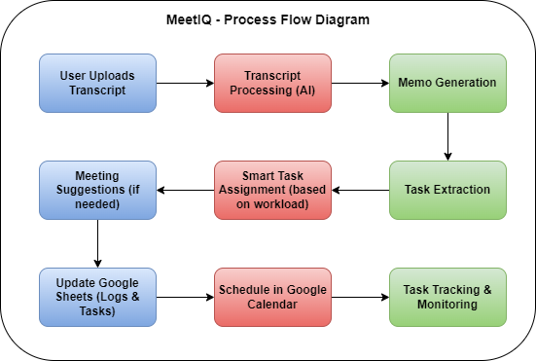
Process flow diagram

Slide 8
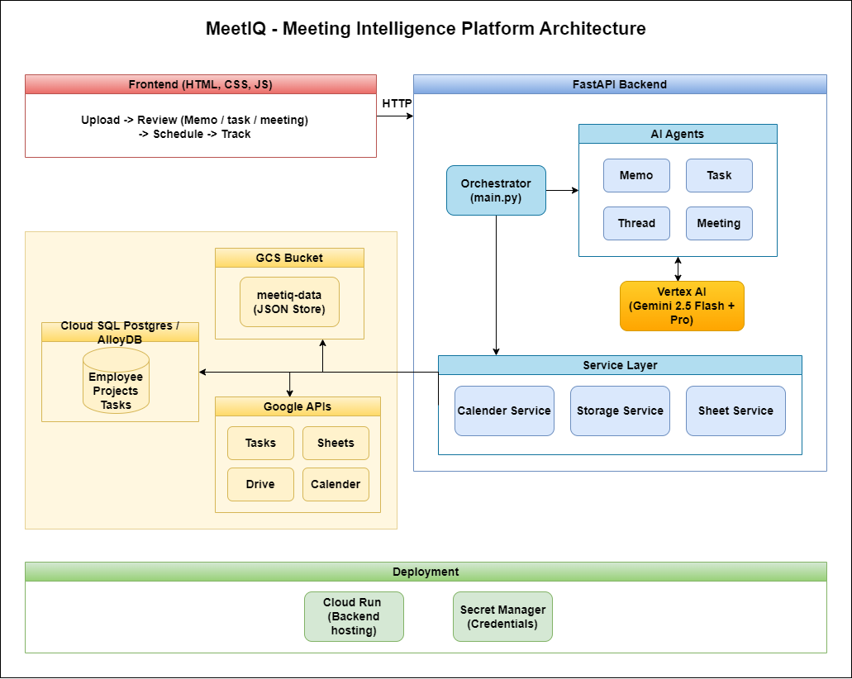
Architecture diagram of the proposed solution:

Slide 9
Technologies/Google Services used in the solution (Why did you choose your specific AI stack and system design, and how does it support scalability and real-world deployment?)
AI & Intelligence : Vertex AI (Gemini Flash & Pro)
Backend & System Design : FastAPI + Python
Agent Frameword : ADK
Google Cloud Platform : Cloud Build & Container Registry, Cloud Storage (GCS), Cloud SQL (PostgreSQL), Cloud Run, AlloyDB
Google Workspace Integration : Sheets, Calendar, Tasks APIs
Why this stack?
Chosen to build a scalable, serverless, and production-ready system where AI handles intelligence, while GCP services ensure reliability, persistence, and seamless real-world integration.

Slide 10
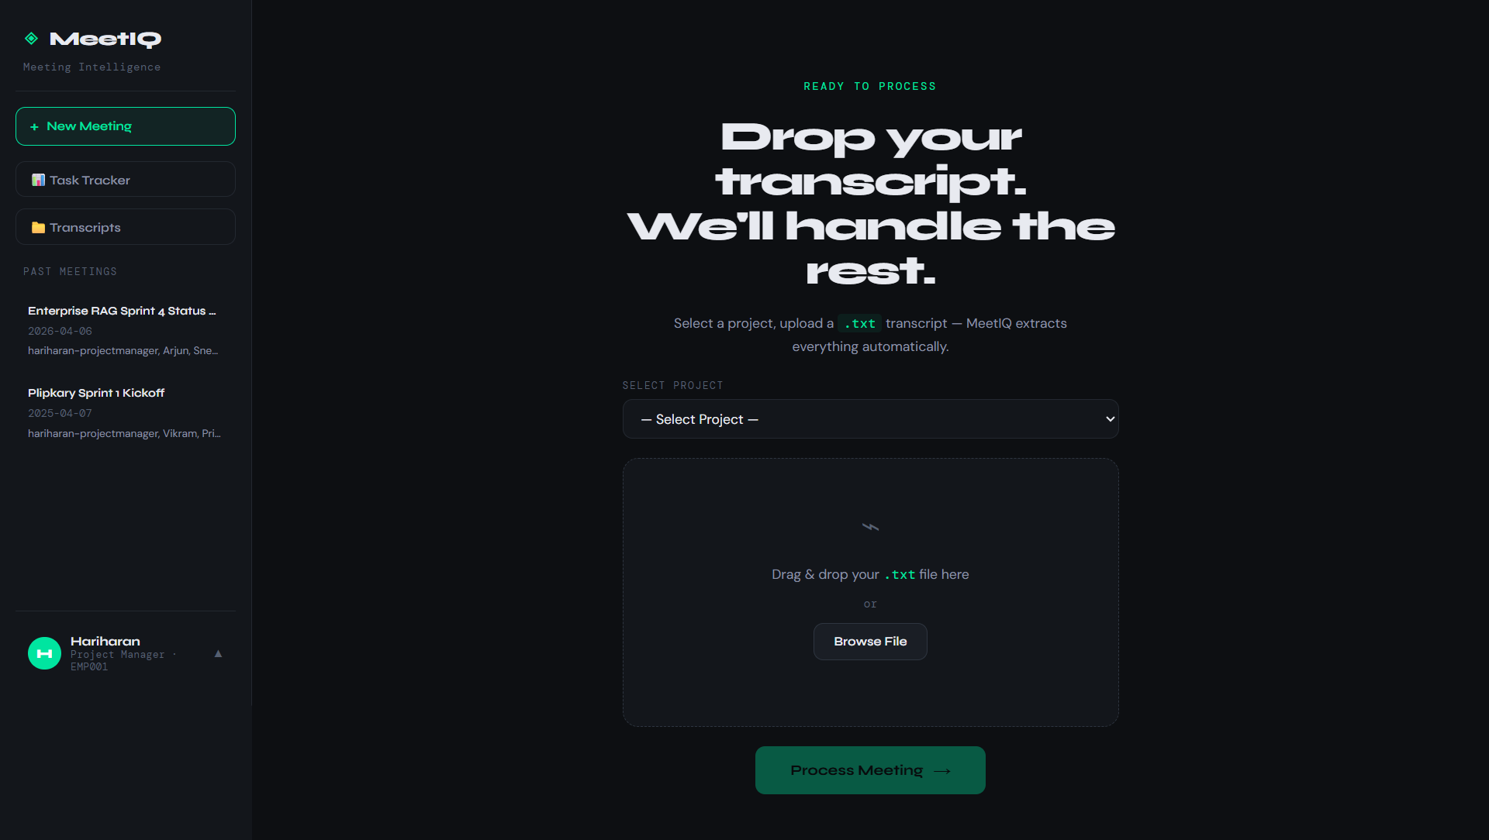
Snapshots of the prototype

Slide 11
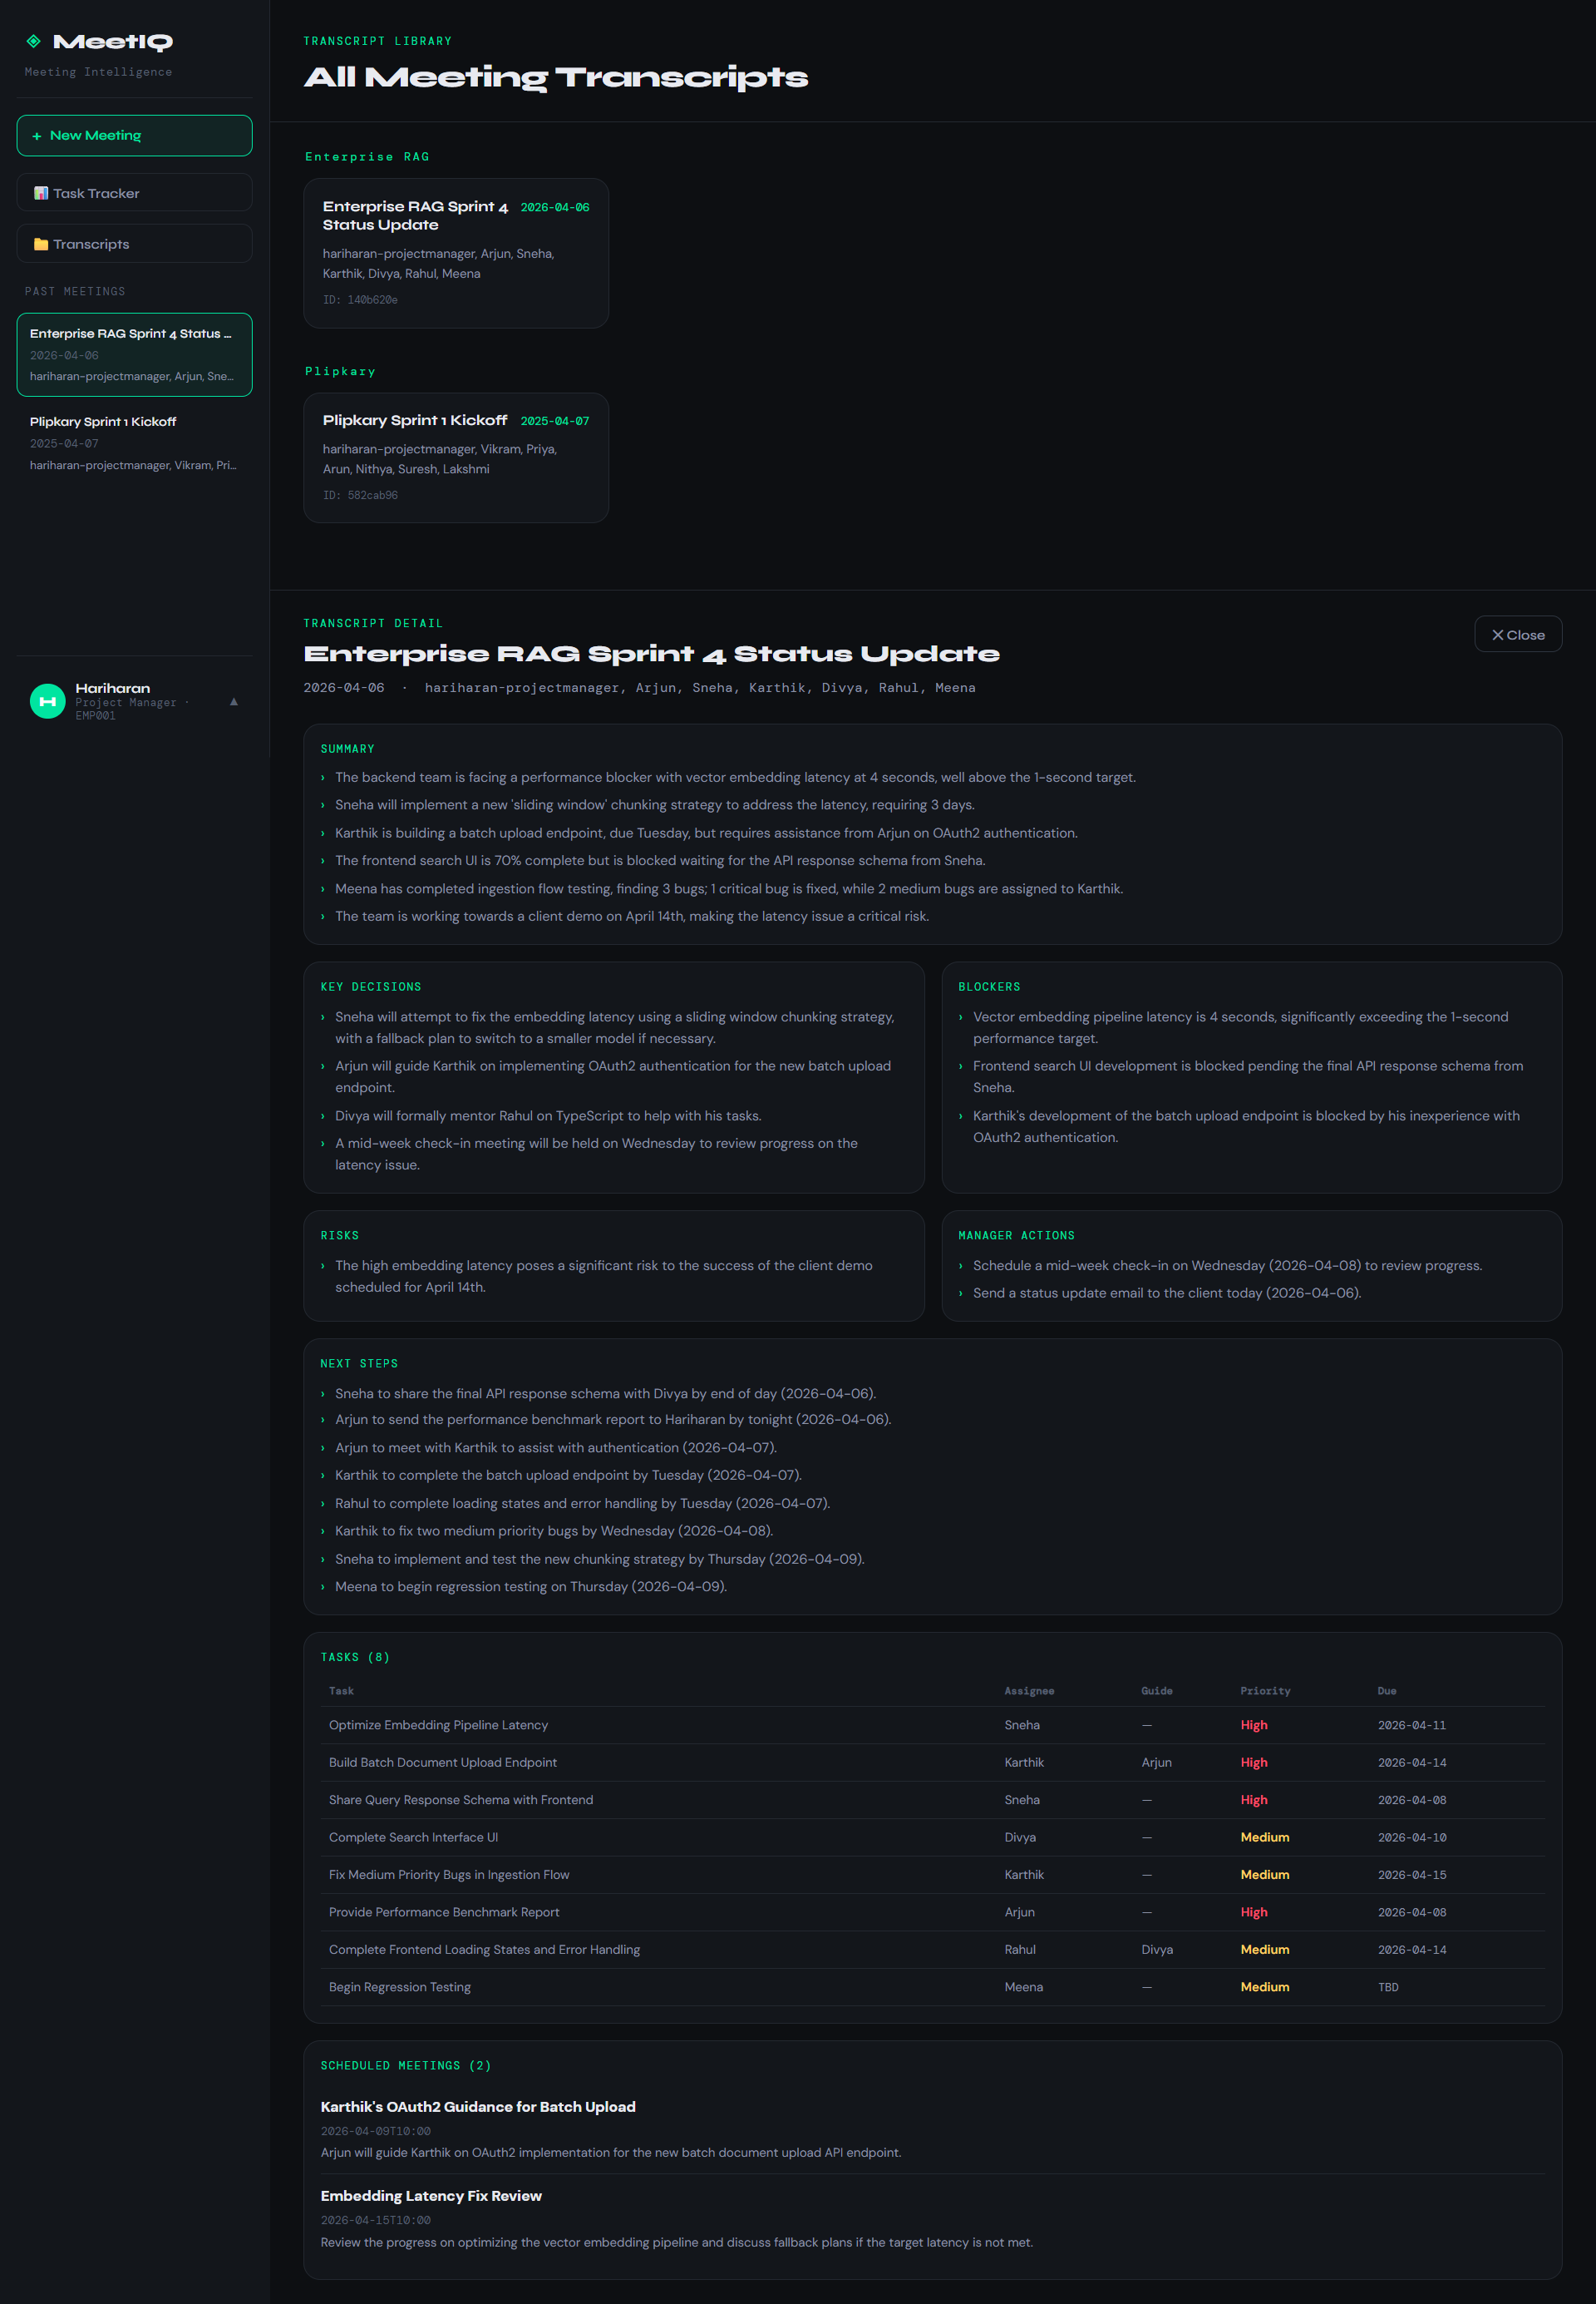
Please go through the Demo video for better portal walkthrough

Slide 12
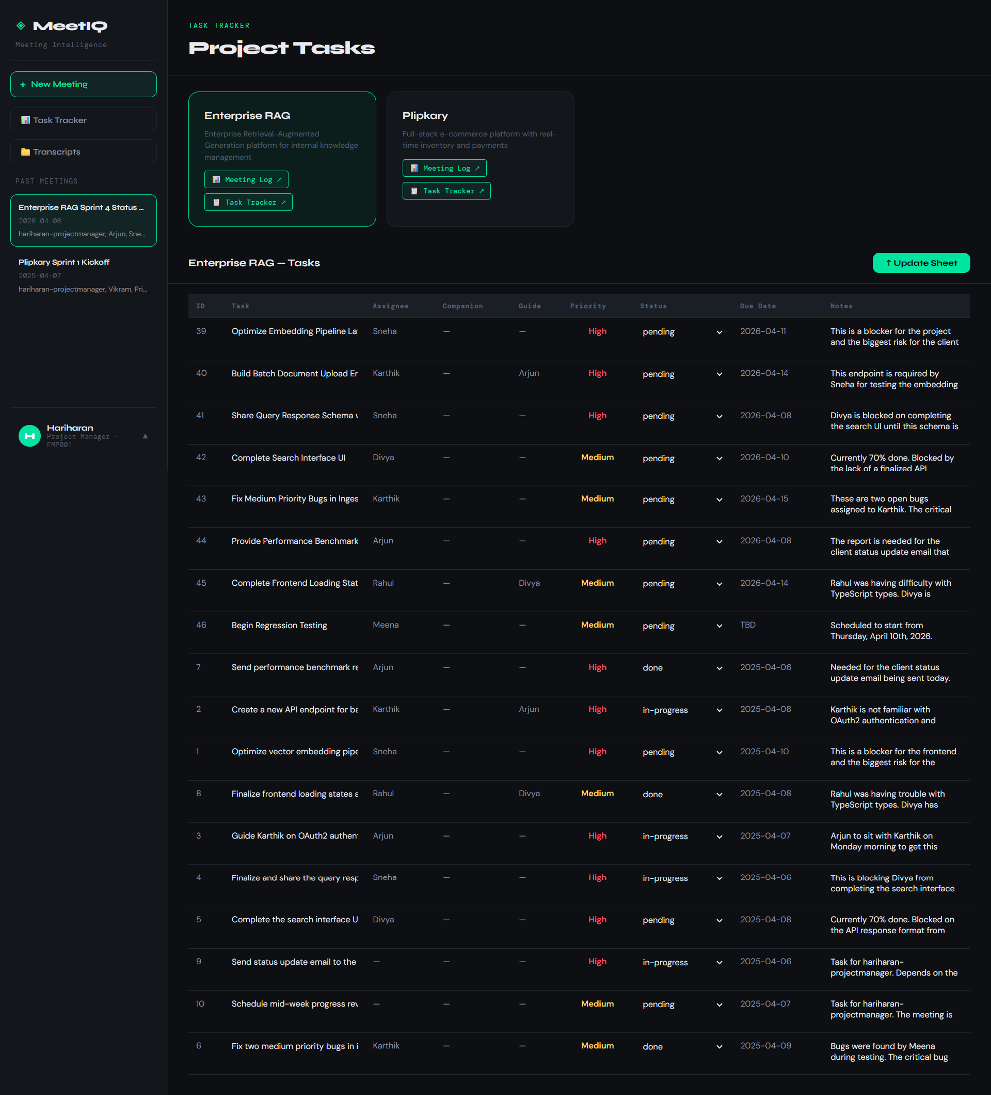
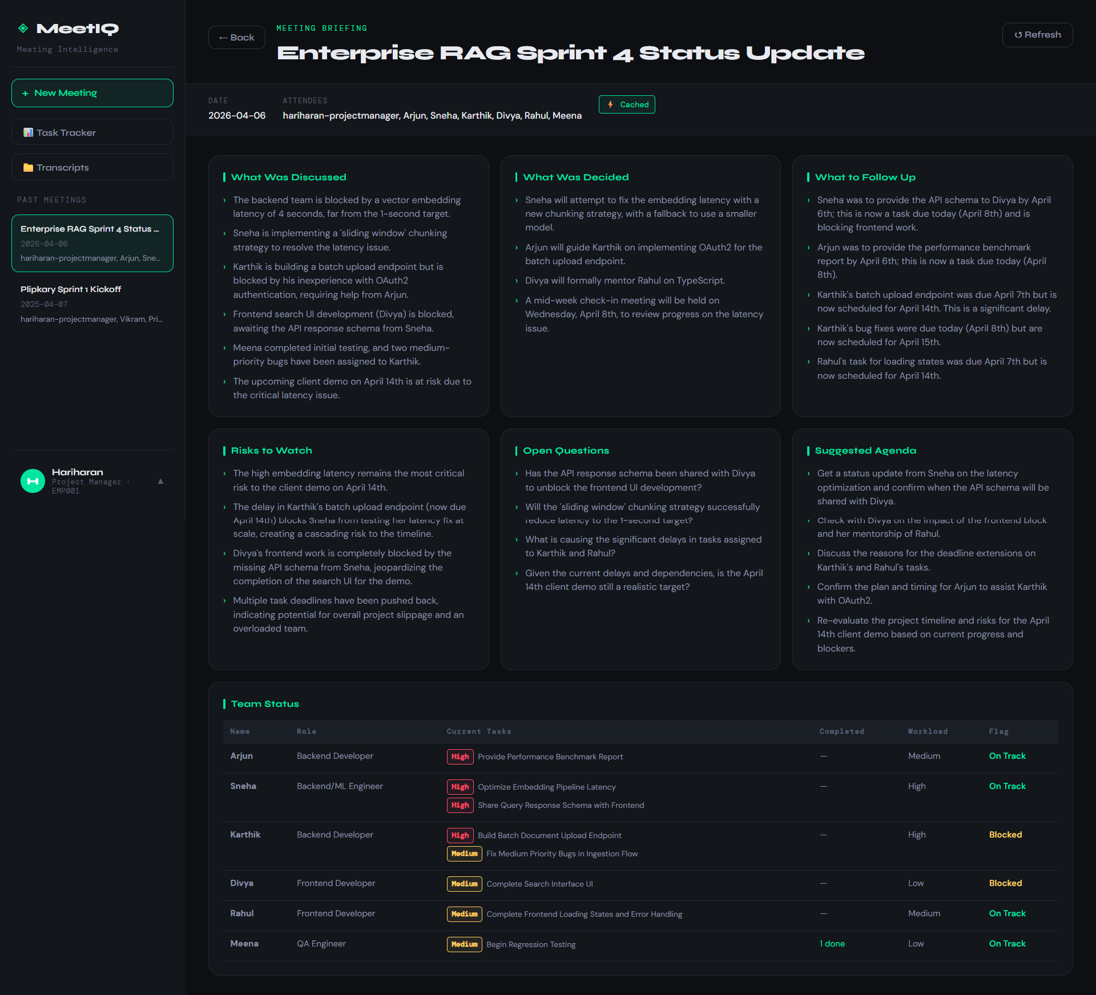

Slide 13
